Slide 1
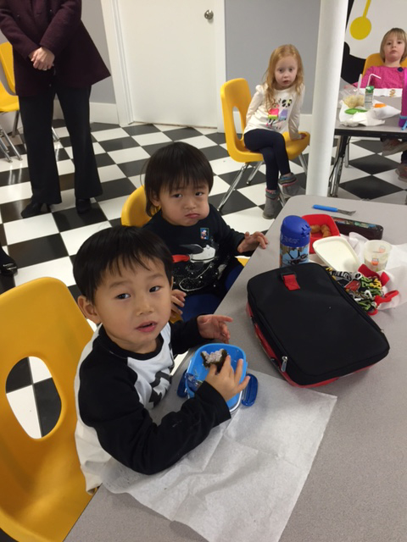
Invest In Kids Scholarship Tax Credit Program
Tax Credits for Donations to Non-Public Schools

Slide 2
Topics to be Covered
What is the Invest In Kids Act?
What it Means for Our Schools
How is it Administered?
Donations and Tax Credits
Basics of the Program
How to Make a Donation and Get a Credit
Summary

Slide 3
INVEST IN KIDS ACT
The State of Illinois House and Senate passed a comprehensive education funding bill this past August (2017) that was signed into law by the governor. The law includes a provision for tax credit scholarships – a 75 Percent income tax credit to individuals and businesses – supporting non-public school scholarships for low-income students in the state.
Illinois students from low-income families may use these new scholarships to attend a non-public school of their choice.

Slide 4
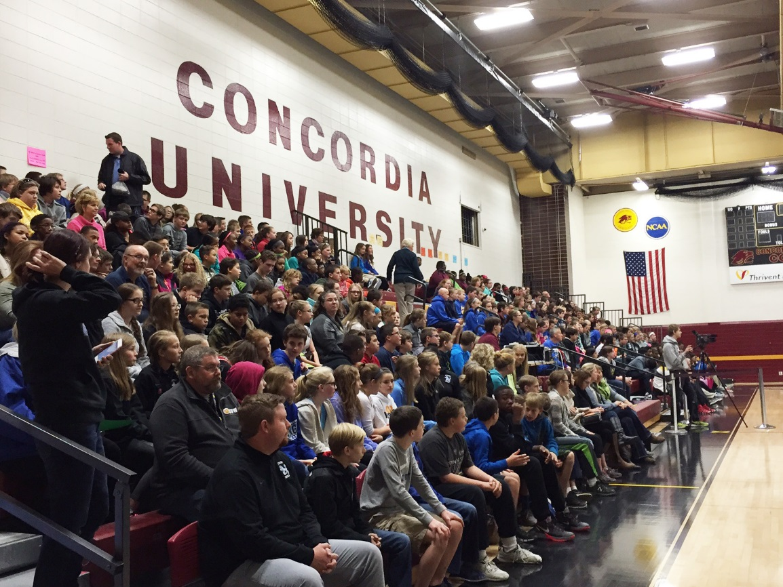
What it Means for Our Schools
The Invest In Kids tax credit scholarship program allows our schools to extend the opportunity to go beyond traditional boundaries, bringing hope to those families and children who could only dream of attending our Lutheran schools.

Slide 5
How is it Administered?
The LCMS Northern Illinois District, as well as the Central and Southern Districts, have partnered with Empower Illinois, a statewide Scholarship Granting Organization (SGO) created in 2017 to serve Illinois children through the state’s tax credit scholarship program.
Empower Illinois connects Tax Credit Scholarship Donations to Illinois students whose education opportunities may be limited by household income.

Slide 6
Donations and Tax Credits
Individuals and corporate donors may receive a credit for their Illinois state taxes equal to 75 percent of donations to an SGO.
Individuals may direct their donations to qualified schools. A list of qualifying schools is available on the Empower Illinois website.
Visit www.empowerillinois.org for complete information on the program, registration as a donor, qualifying schools, and scholarship eligibility.

Slide 7
Basics of the Program
Beginning in 2018, Illinois donor residents and corporations are eligible for a tax credit equal to 75% of donations make to a qualifying Scholarship Granting Organization (SGO), up to $1 million.
Donors must apply for the credit via an application process that opens at 8 a.m. on January 2, 2018; credits are issued on a first come, first served basis.
Individual donors can designate their donation be used to support scholarships at a specific school.
Once approved for a tax credit, the donor must make their donation to the SGO within 60 days of their application date.

Slide 8
How to Make a Donation and Get a Credit
Begin the process by registering/activating your account with www.mytax.illinois.gov.
An ID letter will arrive in the mail (can take up to 10 business days). Sign-up/activate your www.mytax.illinois.gov account.
Reserve your tax credit beginning January 2, 2018. The opportunity will be on a first-come, first served basis. You are encourage to reserve yours as soon as possible.
Once credit has been reserved, you have 60 days to make your donation Empower Illinois at www.EmpowerIllinois.org. Do not send your donation directly to the school.
Claim your tax credit when you file your 2018 Illinois State Taxes.

Slide 9
Summary
We encourage you to begin the process as soon as possible as donations can first be made starting January 2, 2018.
If you know of a corporation which may be interested in this program, please notify your school leader.
To learn more about how the State Tax Credit program works, please talk with your school leader or check out the FAQ’s the Northern Illinois District website. www.nidnews.org/opening-doors-to-students.

