Slide 1
Good Shepherd, Elgin
FAMILY MINISTRY
Lay Leadership Summit
August 24th, 2024
Walther Christian Academy

Slide 2
WHAT IS A FAMILY-FRIENDLY CHURCH?
Building our families’ faith in Jesus is at the core of all that we do!
We are a church that recognizes and embraces the primary influence of parents in the faith development of children.
Our structure and programming reflects this truth.
Church Staff and Church Leadership model this in their lives.
Church “shares the load” with families, NOT taking over for families.

Slide 3
THE CULTURE HAS CHANGED...
The Christian Church is no longer the center of our western culture. (We live in a “Post Christian” culture.)
God has ALWAYS given parents the calling to “Bring them up in the discipline and instruction of the Lord!” (Ephesians 6:4)
The Church is called to support families at home!

Slide 5
“You shall love the Lord your God with all your heart and with all your soul and with all your might. And these words that I command you today shall be on your heart. You shall teach them diligently to your children, and shall talk of them when you sit in your house, and when you walk by the way, and when you lie down, and when you rise.” (Deuteronomy 6:5-7)

Slide 6
FAMILY MINISTRY QUESTIONS
Looking at your calendar, is your family the most important work in your life?
What are three items from this week’s calendar that would indicate this?
Are there changes that need to be made?

Slide 7
THE CHURCH PLAYS A SIGNIFICANT ROLE
IN THE LIFE AND FAITH OF ITS MEMBERS...
Do my church programs pull families “apart?”
Does my church offer classes to nurture families?
Are there programming changes that need to be made?

Slide 8
FAMILY MINISTRY: HOW?
How can the Church walk alongside families as we seek to live out the Great Commission that Jesus has called each of us to be a part of?

Slide 9
OUR MINISTRY PROCESS

Slide 10
WORSHIPING TOGETHER

Slide 11
LEARNING
TOGETHER

Slide 12
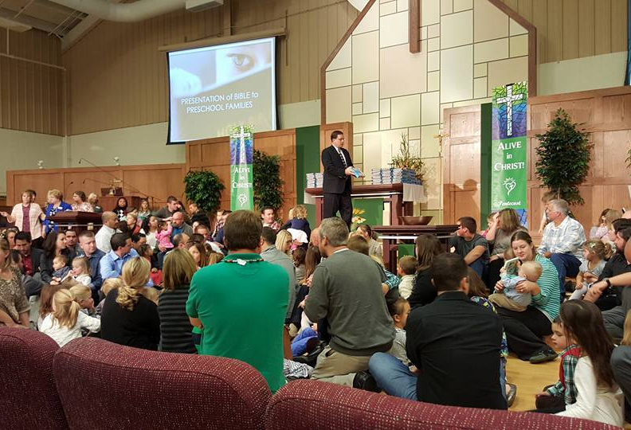
GROWING TOGETHER

Slide 13
PATHFINDERS
MIDWEEK

Slide 14
GATHERING TOGETHER

Slide 15
CARING TOGETHER

Slide 16
CARING TOGETHER

Slide 17
SERVING TOGETHER

Slide 18
SERVING TOGETHER

Slide 19
REACHING OUT TOGETHER

Slide 20
PRESCHOOL OUTREACH

Slide 21
MISSIONAL
COMMUNITIES

Slide 22
MISSIONAL
COMMUNITIES

Slide 23
MISSIONAL
COMMUNITIES

Slide 24
PUTTING IT ALL
TOGETHER...
Jesus said, “All authority in Heaven and on earth has been given to Me. Go, therefore and make disciples of all nations, baptizing them in the name of the Father, and of the Son and of the Holy Spirit, teaching them to obey all that I have commanded you. And behold, I am with you always, to the end of the age.”
Matthew 28:18-20

Slide 25
NEXT STEPS...
In order to grow as a “Family-Friendly Church”,
we plan to __________________________________________________
over the next ____________________________________________
with help from _______________________________________________.
ACTIVITY
TIME FRAME
PERSON

