Slide 1
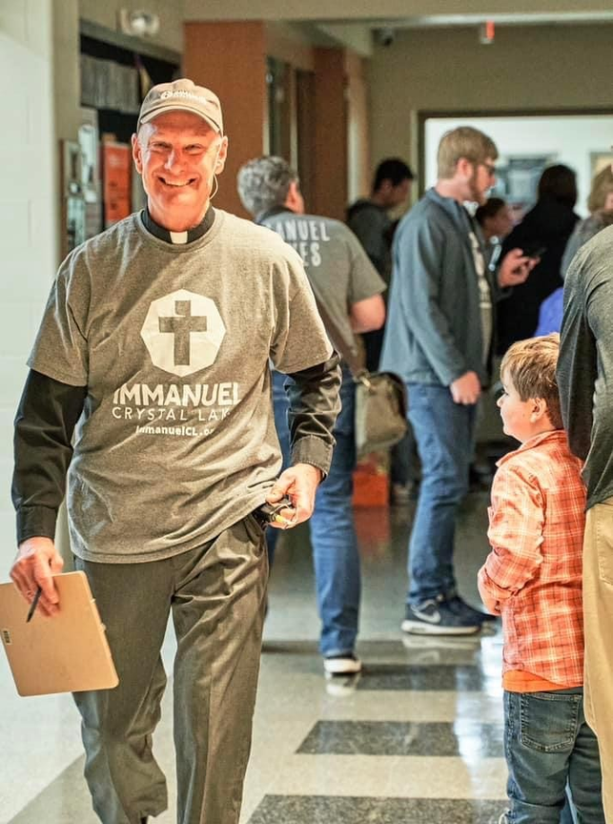
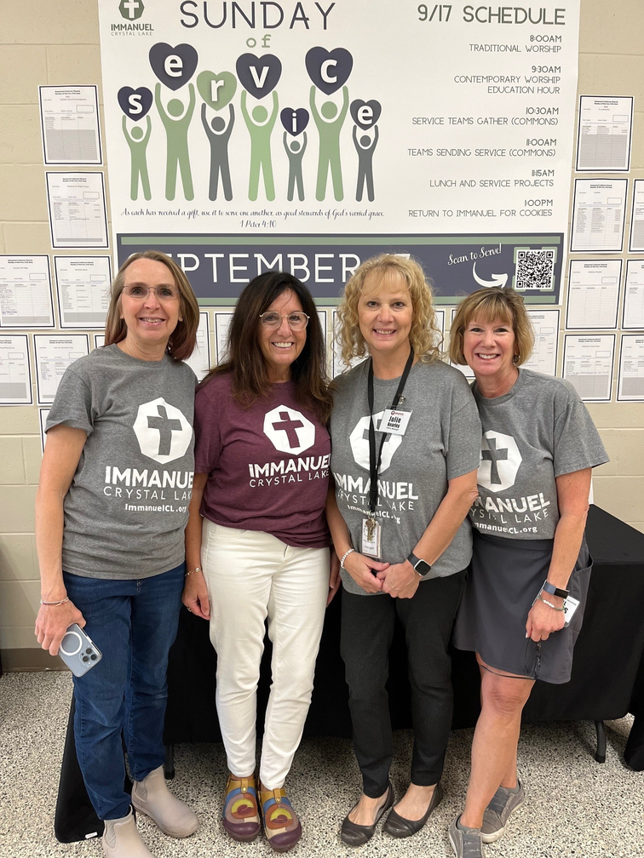

“Volunteers 101"
Pastor Larry Tieman & Sharon Tieman
Immanuel Lutheran Church, Crystal Lake

Slide 2
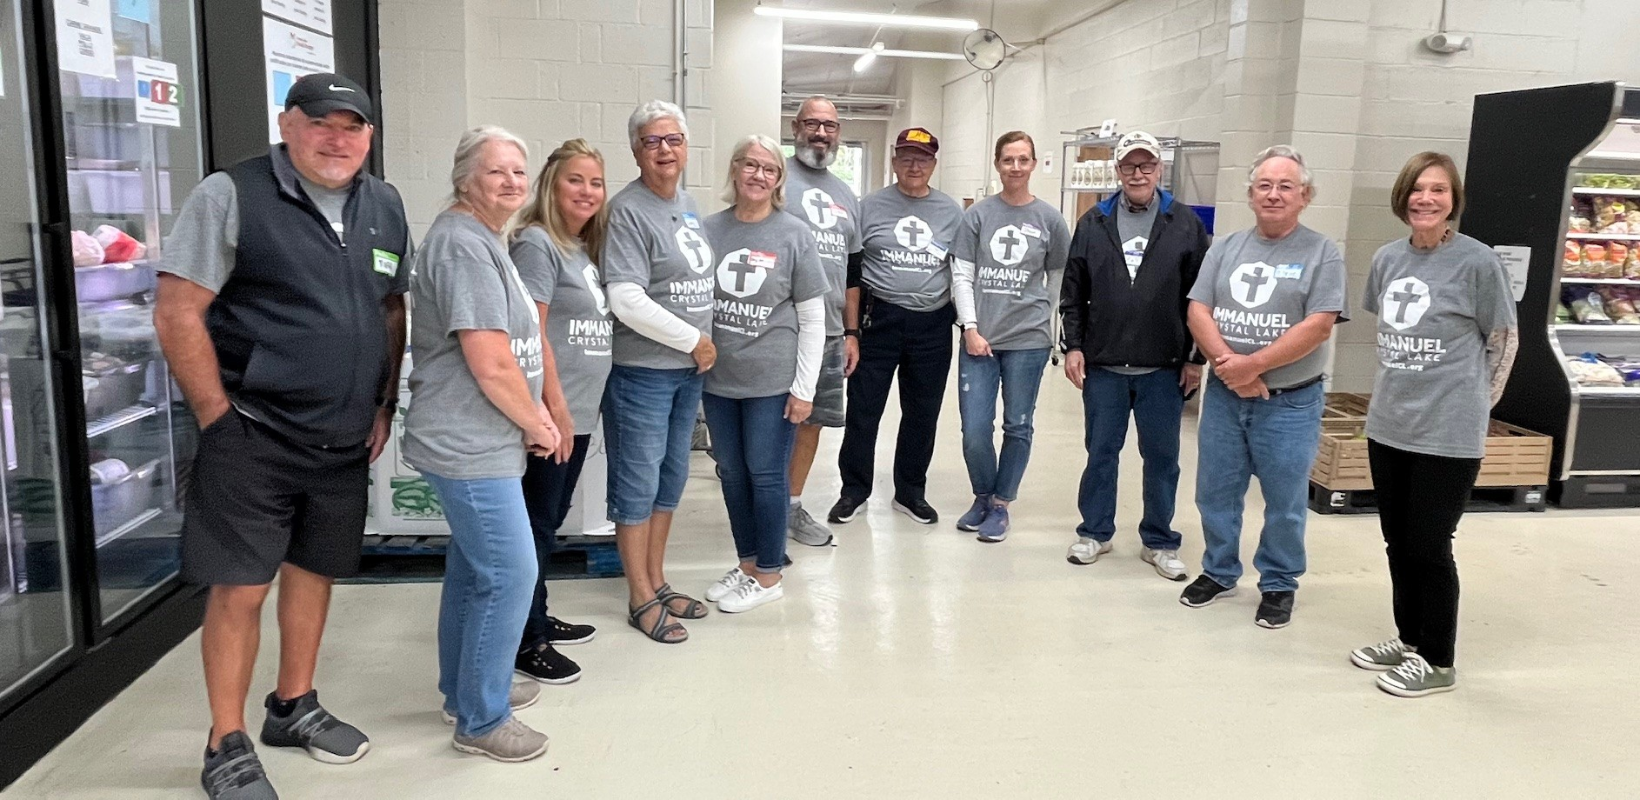
Topics We Will Cover:
Recruiting
Communication
Training
Retaining

Slide 3
The Key: “Having the Right People in the Right Place”

Slide 4
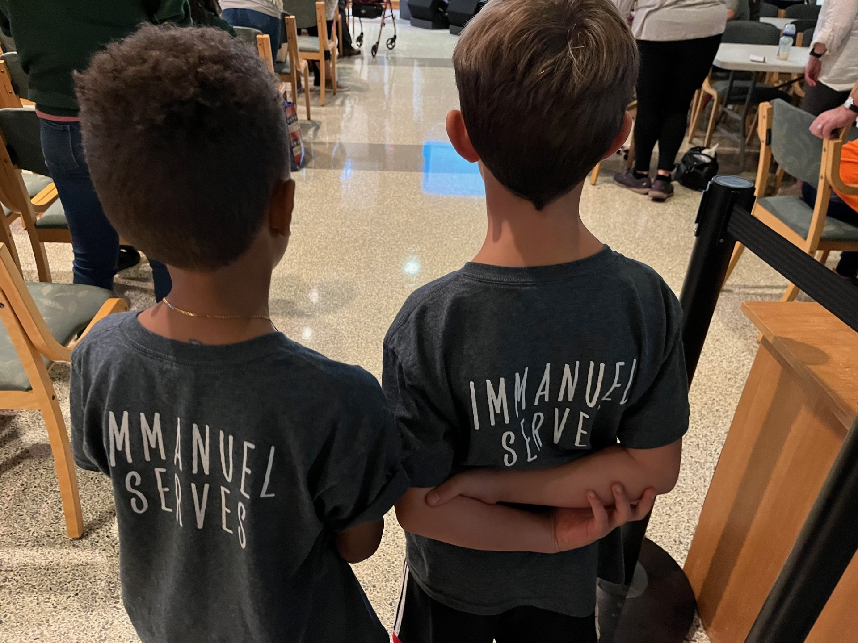
Volunteers Desire To
  Serve
  Make a difference
  Teach their children about service

Slide 5
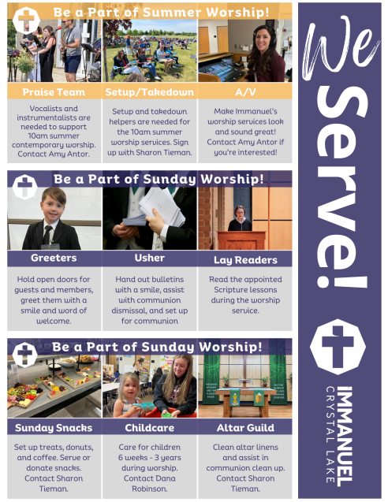
Recruiting Volunteers is more about “Creating a Culture” than “Developing Techniques”
Cast Vision
Tell Stories

Slide 6
Match talents, interests, and passion with ministry
Make ministry accessible
  Lower the bar.
  Let people “try before they buy.”
  Go with “co-leaders.”

Slide 7
Build Relationships
  People gravitate to where they feel valued.
  Help people find their sweet spot.
  Care about your people.
  Begin with new member orientation..
  Collaboration between staff, leaders, and volunteers.

Slide 8

Recruiting Volunteers – Who?
  Members
  School Families – service hour requirement
  Local high school students need volunteer hours
  Young families want to serve together
  Current volunteers find own replacement
  Friends of members – community

Slide 9
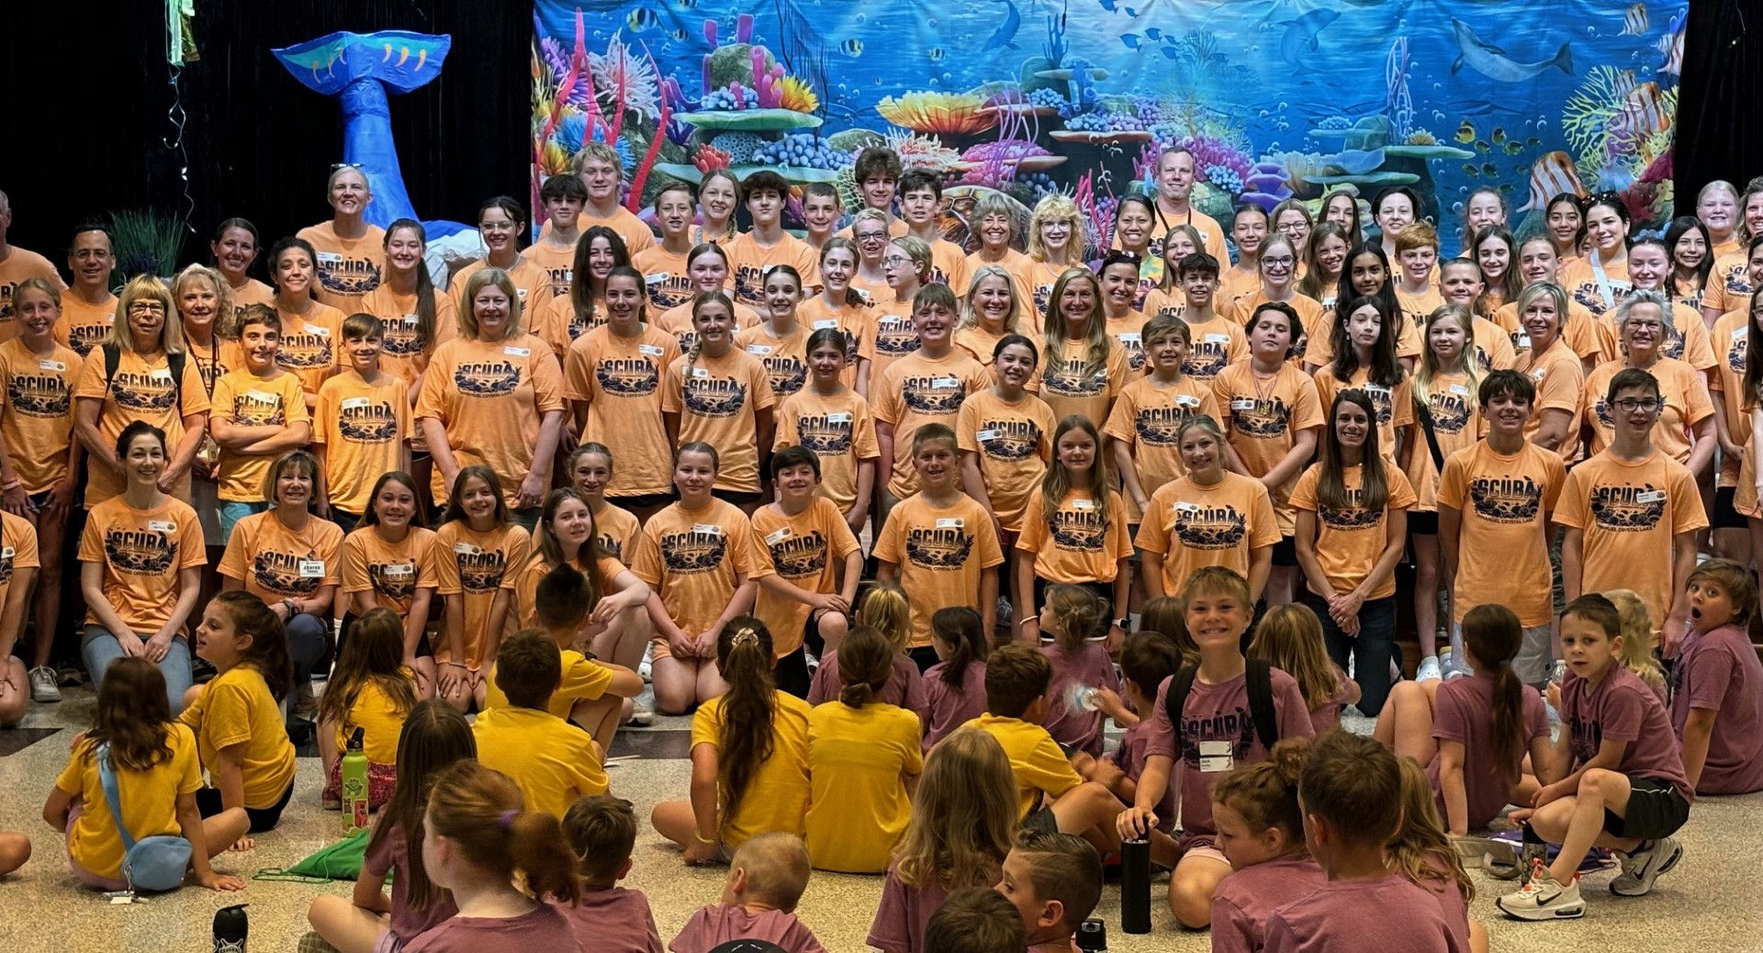
Communicating with Volunteers – Promoting Opportunities
  E-letter
  Bulletin
  Social Media
  Ministry Fair
  Ministry Table/focus
  Personal Ask

Slide 10

Communicating with Volunteers – Getting the Message Out
  Use positive wording “Open spots”
  “Opportunities” vs “We need…”
  Use task force, teams, crews vs committee
  Short term commitments vs long term commitments
  Sign up w friend vs on your own

Slide 11

Communicating with Volunteers – Sign ups and Reminders
  Signup.com
  Sign up lists
  Verbal, email, text reminders

Slide 12

Training Volunteers – Use A Variety of Methods
  Shadow
  Work with leader
  Meetings to train
  Written documents – job descriptions

Slide 13
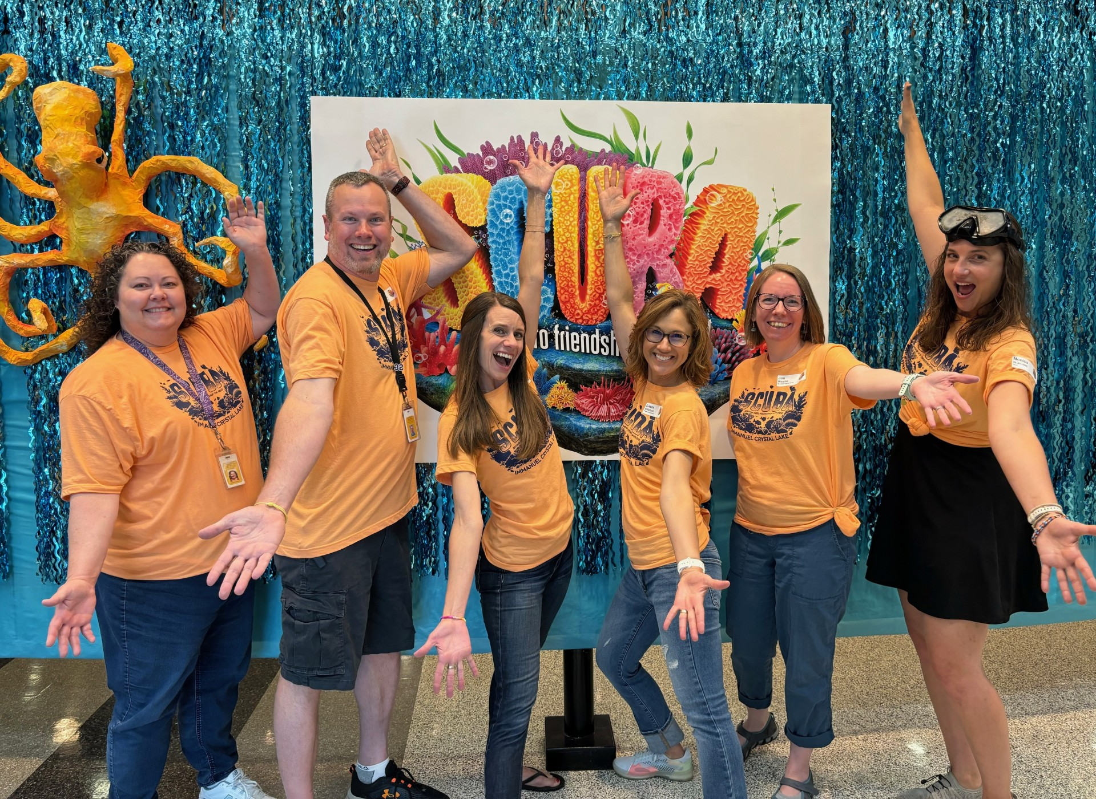
Retaining Volunteers – Things To Do
  Thank them – verbally and written
  Encourage them
  Recognize them
  Feed them
  Have fun
  Thrivent

Slide 14

Retaining Volunteers – Staff and Leaders Work Alongside Volunteers
  Sunday of Service – staff is visible
  Time and Talent Tuesdays – staff leads

Slide 15

Questions

Slide 16

Contact Info
Immanuel Lutheran
300 S. Pathway Court, Crystal Lake, IL
ltieman@immanuelcl.org
stieman@immanuelcl.org

